Slide 1
One hidden layer
Neural Network
Random Initialization
Notes:
In NN it is important to initialize the parameters randomly, 0 will not work.

Slide 2





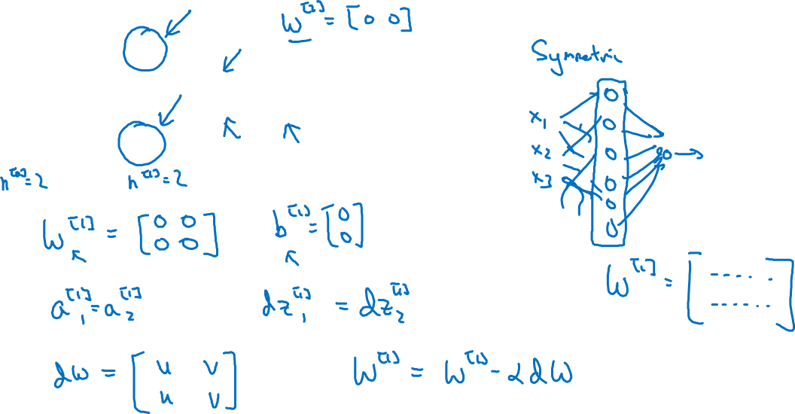

What happens if you initialize weights to zero?
$$x_{1}$$
$$a_{1}^{[1]}$$
$$a_{1}^{[2]}$$
$$\hat{y}$$
$$x_{2}$$
$$a_{2}^{[1]}$$
Notes:
Lets say if we initialize the W1 & b1 as all 0s. For bias it is okay built not for W.
Problem = for any problem the activation of both the nodes will be the same because they will be computing the same function.
Similar dz1 & dz2 will be the same as well, assuming that outgoing weights are equal.
With the iterations, the activations will be performing the same.
The weight update will not be changing anything.
We don’t want all the hidden units to be symmetric.

Slide 3
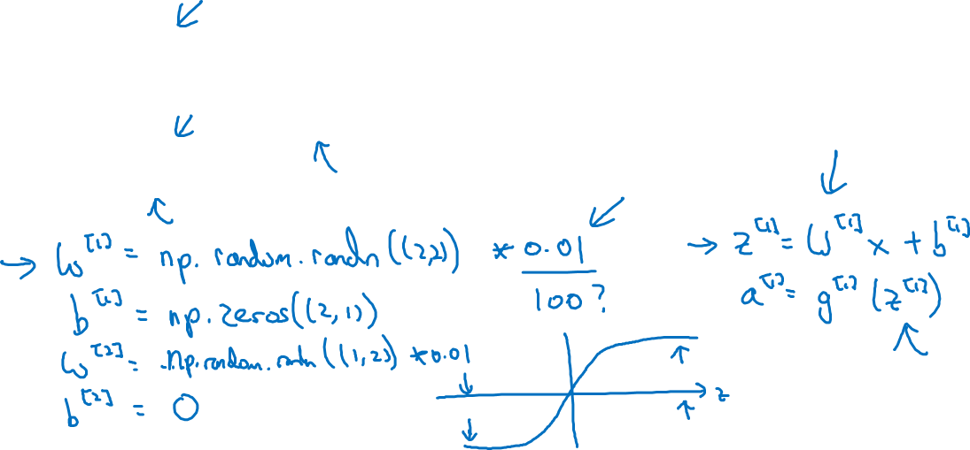
Random initialization
$$x_{1}$$
$$a_{1}^{[1]}$$
$$a_{1}^{[2]}$$
$$\hat{y}$$
$$x_{2}$$
$$a_{2}^{[1]}$$
Notes:
It is okay to initialize b with zeroes.
Question : why 0.01 ,
A: we want to initialize, randomize small weights. If the weights are very large, Z value will be very big which will cause almost stagnant slope, the flat part of the activation function. As a result gradient descent will be slow.
If you don’t have any sigmoid, tanh in your whole network this is less of issue but in binary classification we don’t want this normally.
All the weights.
Sometimes there can better constants than 0.01, specially in deep neural netwroks we want to pick up something different than 0.01.

